Slide 1
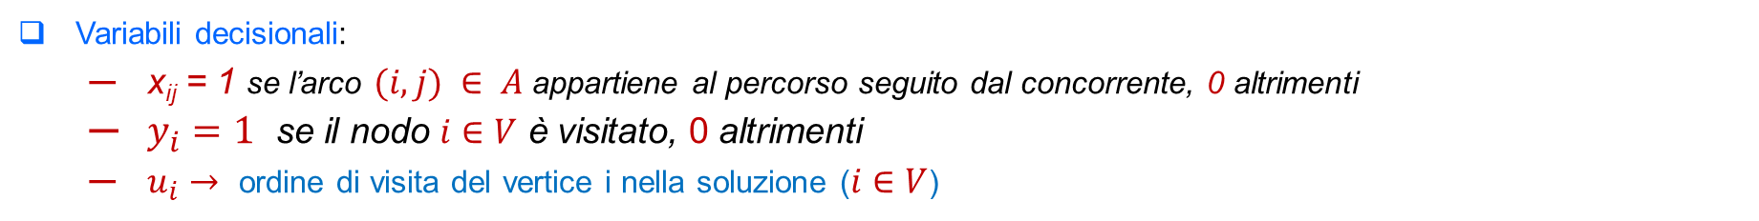
Una generalizzazione del problema del TSP
The orienteering problem con starting point (1) diverso dall’ending point (n) e grafo di input pieno:
Variabili decisionali:
x_{ij} = 1 se l’arco $(i,j) ∈ A$appartiene al percorso seguito dal concorrente, 0 altrimenti
$y_{i}=1$ se il nodo $i∈V$ è visitato, 0 altrimenti
$u_{i}→$ ordine di visita del vertice i nella soluzione ($i∈V$)
Funzione obiettivo:
Vincoli:

Slide 2
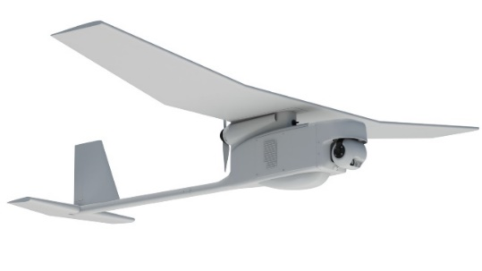
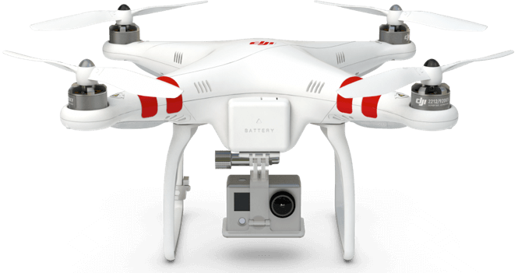
Last-mile delivery with drones
The term drone typically indicates an aircraft that does not carry an on-board operator.
It is capable to fly autonomously or it is maneuvered by an operator in a ground control system .
Peculiarities of drones in operations management problems:
Limited Flight Range
Limited Payload
Handling by a human operator
Specifics of motion
Specifics of information connectivity
One of the most promising application field where the use of drones can result useful is the last-mile logistic.
Several studies showed the benefits, in terms both of emissions and mainly of completion time reduction, that can be achieved by using drones for parcel deliveries.

Slide 3

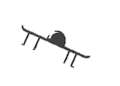
Last-mile delivery systems with drones
Principal delivery systems using drones for transporting parcels
Solution with drones
Solution with a truck and a drone in parallel
Solution with a truck and a drone in tandem
2
3
2
3
2
3
4
4
4
1
1
1
depot
depot
depot
5
5
5
7
6
7
6
7
6
Truck movement
The Flying Sidekick Traveling Salesman Problem (FSTSP) was the first model proposed in literature for a delivery system with a truck and a drone in tandem.
Drone movement

Slide 4
FSTSP – Problem statement
The Flying Sidekick TSP is a variant of the traveling salesman problem involving drone-assisted parcel delivery
The FS-TSP is a delivery problem in which a truck and a drone (unmanned aerial vehicle UAV) are used as a synchronized working unit to make the delivery process more efficient and, possibly, less expensive.
Drone tasks
the drone is launched from the truck,
it proceeds to deliver goods to a customer
it joins back the truck before its endurance is exhausted
Truck tasks
while the drone is serving a customer, the truck travels to deliver parcels to other customers
it has to recover the drone before finishing the endurance of the drone
it can serve other customers when the drone is “on board”

Slide 5
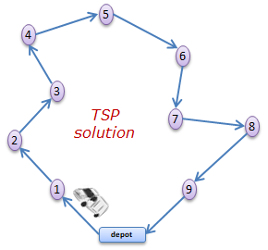
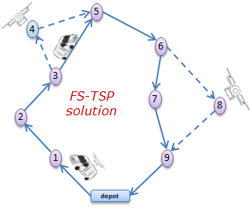
FSTSP – Problem statement
The Flying Sidekick TSP is a variant of the traveling salesman problem involving drone-assisted parcel delivery
The FS-TSP is a delivery problem in which a truck and a drone (unmanned aerial vehicle UAV) are used as a synchronized working unit to make the delivery process more efficient and, possibly, less expensive.
Example:
Serving two customers with the drone instead of the truck can reduce the overall delivery time required to serve all the customers.

Slide 6
FSTSP – Problem statement
The Flying Sidekick TSP is a variant of the traveling salesman problem involving drone-assisted parcel delivery
The FS-TSP is a delivery problem in which a truck and a drone (unmanned aerial vehicle UAV) are used as a synchronized working unit to make the delivery process more efficient and, possibly, less expensive.
FS-TSP requires to decide:
The route performed by the truck
The set of clients served by the drone (the drone can only deliver parcels to eligible customers – payload capacity)
the launch node and the pick-up node for each drone flight (considering the endurance limit of the drone)
Objective: minimize the overall delivery time

Slide 7
FSTSP assumptions
FSTSP main assumptions (Murray and Chu 2015)
Each customer must be served once by either the tuck or the drone (truck only customers are present).
The truck and the drone depart and return to a single depot exactly once.
The truck has an infinite capacity and acts as a mobile depot for the drone.
The drone has a limited endurance in terms of flight time and can serve one customer for flight.
Each sortie may begin either at the depot or from a customer location.
Prior the launch, a service time is required for the driver to change the battery and load the parcel.
The second node of a sortie must be a customer served by the drone.
The third node may be either the depot or a customer location where the drone meets the truck (each customer cannot be re-visited by the truck just to retrive the drone).
For each sortie that ends at a truck location, then another service time is required for the driver to recover the drone.
Objective: minimize the time required to serve all the customers and come back to the depot.

Slide 8
FSTSP formulation
The depot is splitted into two nodes, an origin node ($s$) with only outgoing arcs and a destination node ($t$) with only incoming arcs.
$G(V,A)$ is the complete directed graph where $V=C∪\{s,t\}$ and $A$ is the set of arcs.
$∀(i,j)∈A$, $t_{ij}$ is the truck travelling time and $d_{ij}$ is the drone travelling time.
$SL$ and $SR$ are the drone launch and recovery time, respectively.
$Dtl$ is the drone time limit.
Binary decision variables:
$(i,j)∈A$ $y_{ij}=1$ if the arc (i,j) belongs to the truck path
$\left(i,j\right)∈A h ∈C$ $y_{ij}^{h}=1$ if the arc (i,j) is crossed by the truck while the drone is serving $h$
$h∈C$ $θ^{h}$=1 if client h is served by the drone
$i∈V h∈C$ $ω_{i}^{h}=1$ if node i is the origin node of the sortie serving client $h$
$i∈V h∈C$ $δ_{i}^{h}=1$ if node i is the destination node of the sortie serving client $h$
Continuous decision variables:
$h∈C$ $σ^{h}$ is the waiting time of the truck at the destination node of the sortie serving client $h$

Slide 9










FSTSP formulation
Binary decision variables:
$(i,j)∈A$ $y_{ij}=1$ if the arc (i,j) belongs to the truck path
$\left(i,j\right)∈A h ∈C$ $y_{ij}^{h}=1$ if the arc (i,j) is crossed by the truck while the drone is serving $h$
$h∈C$ $θ^{h}$=1 if client h is served by the drone
$i∈V h∈C$ $ω_{i}^{h}=1$ if node i is the origin node of the sortie serving client $h$
$i∈V h∈C$ $δ_{i}^{h}=1$ if node i is the destination node of the sortie serving client $h$
Continuous decision variables:
$h∈C$ $σ^{h}$ is the waiting time of the truck at the destination node of the sortie serving client $h$
Example of feasible solution
h
$$θ^{h}=1$$
$$σ^{h}=max⁡(0, d_{jh}+d_{hq}−t_{jp}−t_{pq})$$
$$ω_{j}^{h}=1$$
$$δ_{q}^{h}=1$$
$$y_{jp}^{h}=1$$
$$y_{pq}^{h}=1$$
i
j
p
q
r
$$y_{ij}=1$$
$$y_{jp}=1$$
$$y_{pq}=1$$
$$y_{qr}=1$$
Notes:
Sigma_h è zero se arriva prima il drone e poi il camion, l’altra espressione si ha quando è il camion che aspetta il drone

